Slide 1


End-To-End Secure Transfer
Internal Drive
NINJA TEAM

Slide 2
Overview
01
Why Internal Drive ?
02
What is the services Provided ?
03
What is the Features provided ?
04
What is the Future prospects ?
05
What is the Work division plan ?

Slide 3
Why Internal Drive ?
Simple work in small LAN, Required two end point at least to work correctly one of them is a Server and another is the client.
Running in most OS (mac,windows and linux) and Smart devices which support Android OS .
User interact more closely by animation and colors more comfort and do a lot of actions download ,upload and chatting .
Centralization data storing with a lot of secure method to keep files saved.
Secure data sharing by high level of encrypting algorithms .
Provided multi and direct sharing in one click.

Slide 4
What is the services Provided ?
Technology:
Client/Server(RMI ,Socket), Cryptography(AES,RSA), Programming (Java, Node JS , Android, javafx), file system (.Json , .csv , .xls, .enc).
Core services :
Support encryption/decryption using standard encryption algorithms (AES and RSA) for any file.
Support public/private key generation.
Support a handshaking protocol where the parties exchange a common key for AES-encrypted communication.

Slide 5
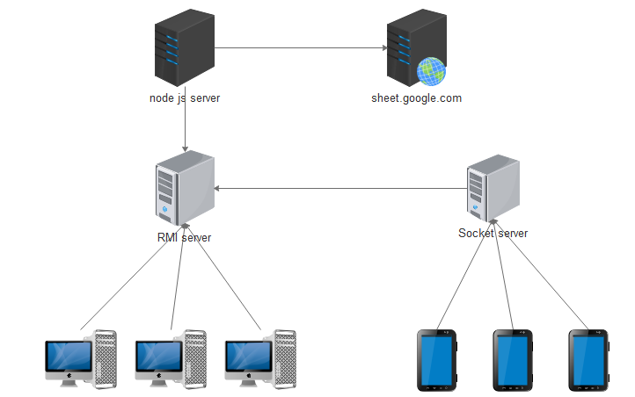

What is the services prospects ?

Slide 6
What is the Features Provided ?
Extras :
Support public key acquisition via SSH public key.
Support multiple levels of AES .
Support text communication as well as file transfer.
Support Full encryption .
Support Part encryption .
Support Data analyzes using node Server and google sheet service .
Mobile application (Android OS).
Support multi platform .
Running online and offline .
Support Drive account .
Support workshop sharing .

Slide 7
What is the Future prospects ?
Deployment application on global server
Building web application can sync with server
Developing IOS application .

Slide 8
What is the Future prospects ?
Full & part encryption
Malty AES Key
Node JS server
Google site
Vertical Extra
Socket server
Multi threading
Basic UI ,network exchange
RMI Server
Core requirement
Horizontal Extra

